Slide 1
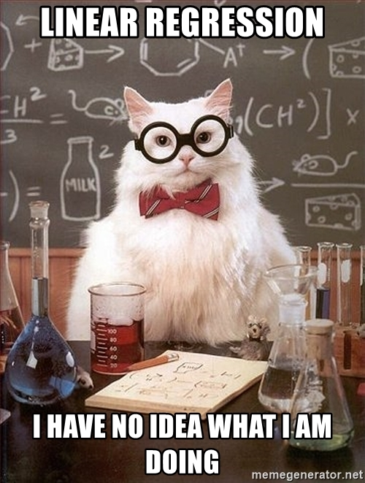
Image Source

Slide 2
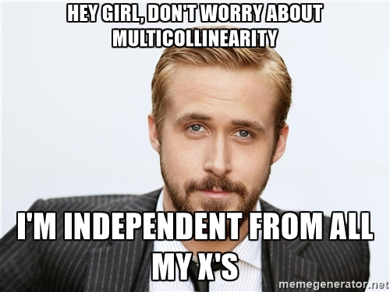
Image Source

Slide 3
Welcome to Week 16, Lecture 02!
Diagnosing and Interpreting Linear Regression

Slide 4
Agenda
Assignments
Announcements
Last Class:
Why Use Linear Regression?
How does Linear Regression work?
What are coefficients?
The 4 Assumptions of Linear Regression
Demo: How to fit a linear regression with statsmodels.
Today:
Demo: How to fit a linear regression with statsmodels.
Diagnosing a Regression model
Iterating on our model
Advanced approaches for multicollinearity
Coefficient Interpretation

Slide 5
Assignments
Only 1 required assignment:
Project 3 - Part 4(Core)
Highly Recommended:
Do Project 3 - Part 5 for your portfolio!!!
Week 3 assignment feedback added!
Final Assignment Deadline = Friday at 9 AM PST!
All resubmissions from week 1 and 2 .
All week 3 and 4 assignments turned in.
Grace Period for Week 3 Resubmits:
If you are asked for resubmissions for week 3 assignments, the deadline for submitting those is Monday at 9 AM PST.

Slide 6
📣 Announcements
🙏 Please take a few minutes to fill out the End of Stack survey. 🥺 https://login.codingdojo.com/dashboard/end-stack-survey
🎓 Online DS Graduation!
Friday, May 27th @ 5 PM PST
Our cohort + students from 12 week program.
In the same Zoom Room as lecture
Bonus Lecture Tomorrow:
Topic: Creating Your Own Python Package/Module
Date: Friday 05/13/22 @ 5 PM PST
We will start with a review of writing functions
Then discuss moving our functions to an external .py file (making a module)
Then we will discuss how to make an actual PyPi Package (pip-installable)

Slide 7
Linear Regression Assumptions

Slide 8
The 4 Assumptions of Linear Regression
The first 2 assumptions are about the features:
Linearity
Independence of features (AKA Little-to-No Multicollinearity)
The last 2 assumptions are about the residuals (errors):
Normality
Homoscedasticity

Slide 9
Fitting a Linear Regression with Statsmodels

Slide 10
Linear Regression Modeling is Iterative
Be prepared to try MANY versions of your model with changes to your features.
Functionize your data prep and evaluation process for easy iteration.
Keep your notebook organized with headers!
Add a header for each iteration of your model.

Slide 11
Walkthrough: Linear Regression with statsmodels
Fitting a linear regression to predict movie revenue.
Basically, the optional assignment: Project 3 - Part 5.
Repo: https://github.com/coding-dojo-data-science/data-enrichment-linear-regression-with-movies
Last Class:
Preparing the data for a statsmodels OLS.
Fitting an OLS model.
Next Class:
Interpreting the Model Summary and its coefficients.
Diagnosing the model
Better meeting the assumptions
Advanced approaches to dealing with multicollinearity
BUT BEFORE WE DIVE BACK IN….

Slide 12
Diagnosing Linear Regression Models

Slide 13
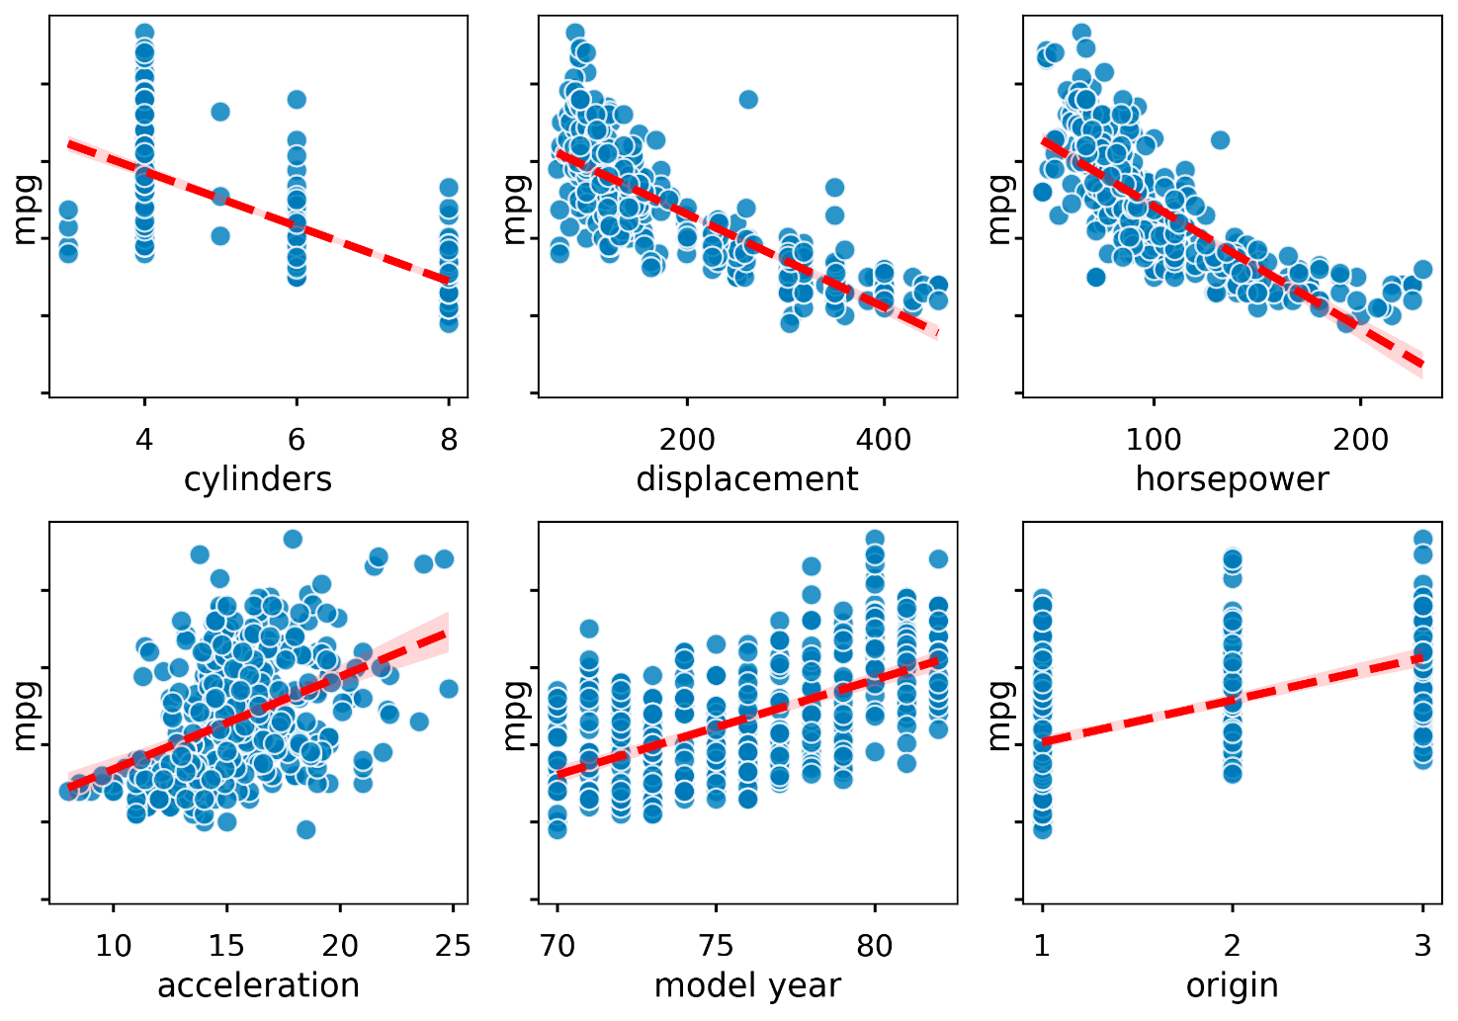
Assumption of Linearity
That the input features have a linear relationship with the target.
To check:
Use visualizations!

Slide 14
If your features violate linearity
Simplest solution:
Drop features that are not linearly correlated with target.
More Advanced Solutions (not covered today):
Transform your non-linear features into PolynomialFeatures.
Towards Data Science: Polynomial Regression
Machine Learning Mastery: Polynomial Feature Transformations
When all else fails:
Try a different type of regression!

Slide 15
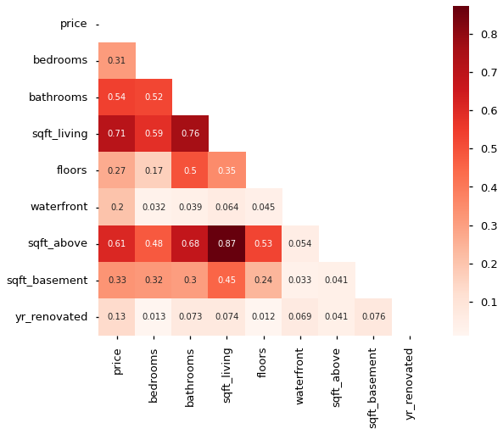
Independence of features
(AKA Little-to-No Multicollinearity)
That the features are not strongly related to other features.
To Check:
Use correlation heatmaps!
Look for condition number warning on model.summary()

Slide 16
If your features violate no multicollinearity
Change argument for your OneHotEncoder:
Add drop=’first”
But can’t use handle_unknown=’ignore’
Use Variance Inflation Factor! (will demonstrate today)
Get VIF Values for your features.
Examples:
https://www.geeksforgeeks.org/detecting-multicollinearity-with-vif-python/
Drop features with a score > ~5
Try creating “interaction” features to combine 2 features that are highly correlated. Chris Albon Article on Interactions

Slide 17
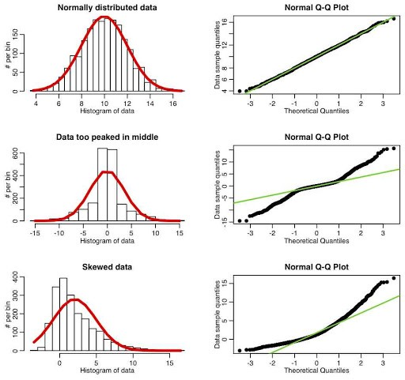
Normality (of residuals)
The model's residuals are approximately normally distributed.
To Check:
Use a Quantile-Quantile (Q-Q) Plot!
Resource:
https://towardsdatascience.com/q-q-plots-explained-5aa8495426c0
Source: Sherrytowers Q-Q plot examples

Slide 18
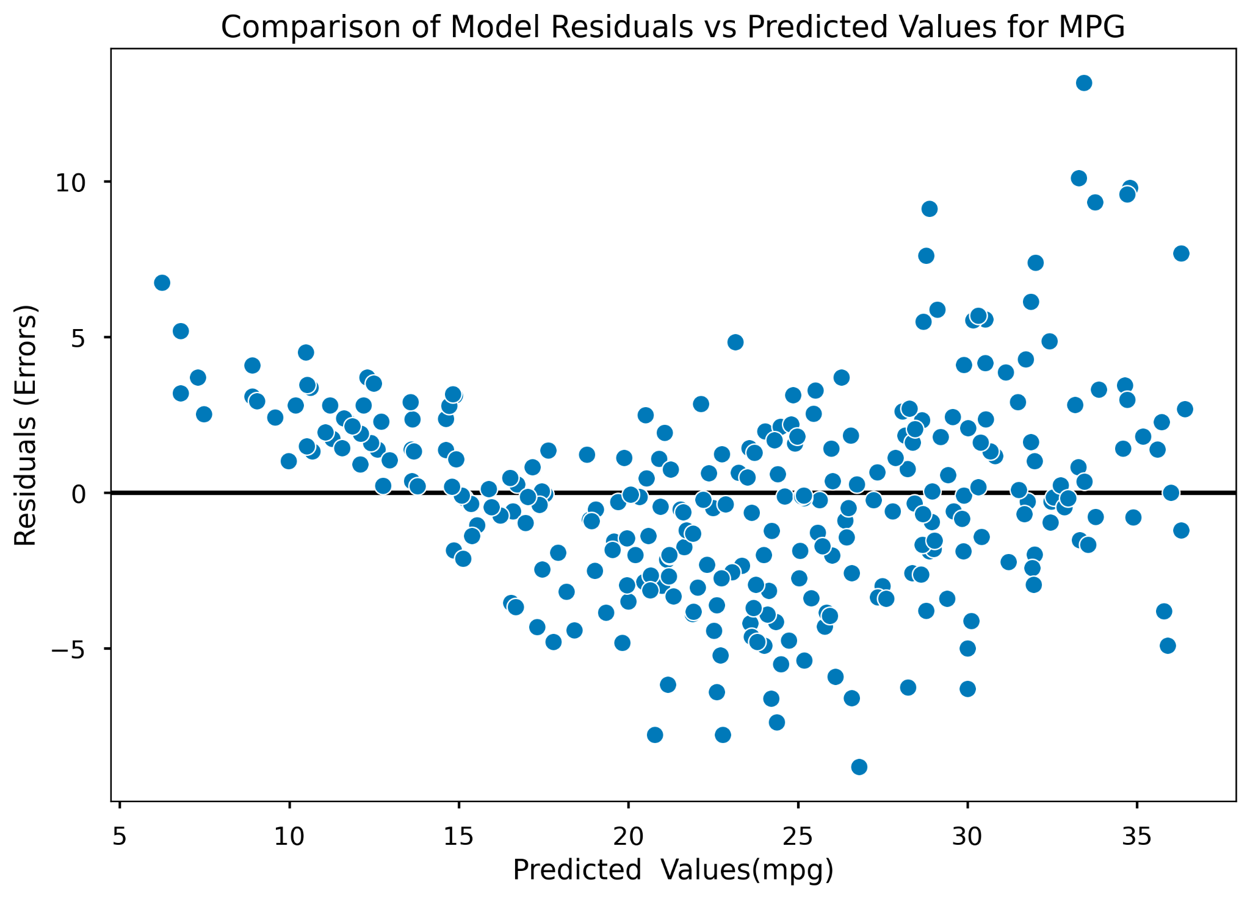
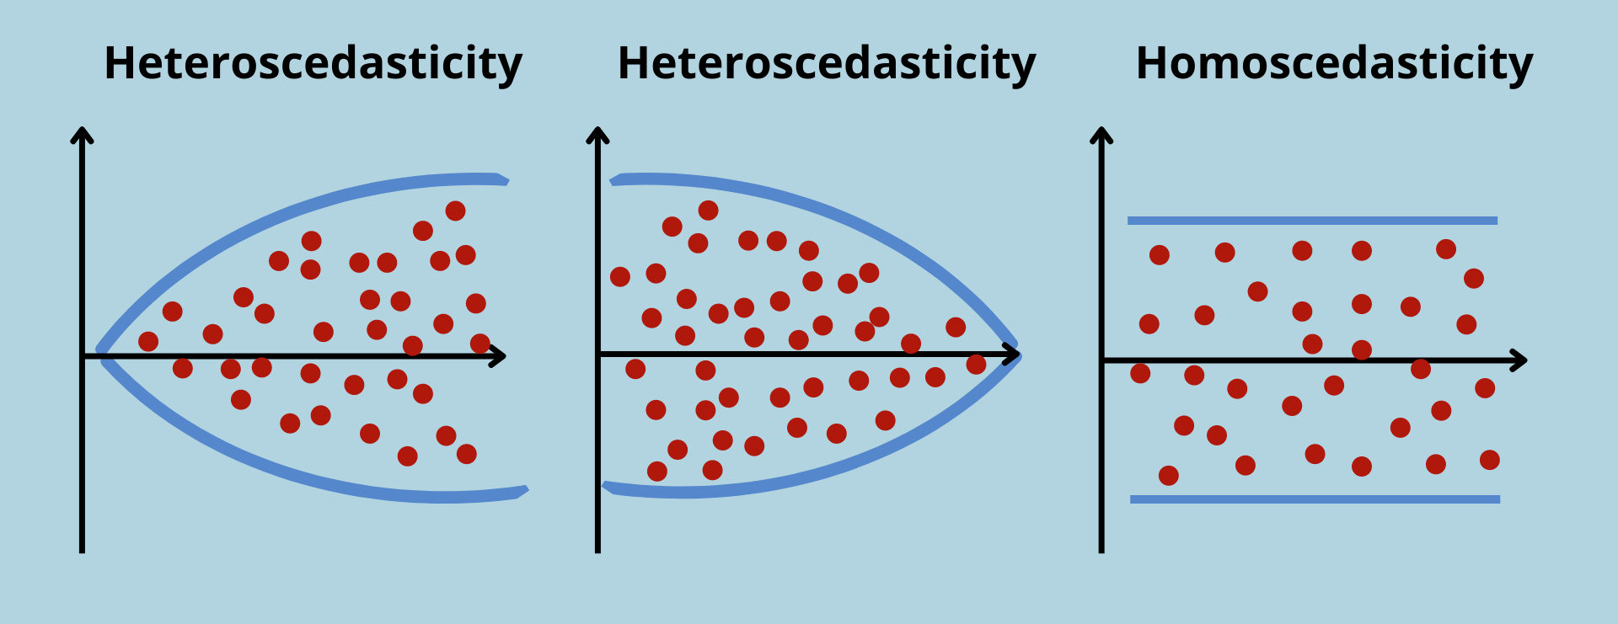
Homoscedasticity (Equal Variance)
The model residuals have equal variance across all predictions.
To Check:
Plot a residual scatter plot!
X-axis: Predicted Y-Values
Y-axis: Residuals (y-y_pred)

Slide 19
Model Diagnostics: After Each OLS Model
Display the model.summary()
Check R-Squared/Adj R-Squared
Get predictions and calculate residuals.
Plot a QQ-Plot of the residuals to check for assumption of normally distributed residuals.
Plot a scatter plot of the model’s predictions (X) vs the residuals (y) to check for homoscedasticity.
Check the P-Values of your coefficients.
Drop any that are not significant.
OHE Columns are dropped All-or-None.
If the majority of the column’s coefficient are significant, keep them all.
If the majority are not significant, drop them ALL.

Slide 20
If you violate either residual assumptions -1
Check for outliers in your target and your numeric features.
1) Try the Z-score rule for outliers first.
2) If still violating residual assumptions, try using the IQR outlier rule
We will demonstrate in activity
Perform on the ORIGINAL data, not the z-score outlier-removed data.
3) Revisit your numeric features and check if you have a nonlinear feature (if so, remove it).
Note: Remember to tell your stakeholders what range of your target was used in the model.
“My model was designed to predict homes with a value < $2million”

Slide 21
If you violate either residual assumptions-2
More extreme solutions:
Forcing your numeric features to be more normally distributed using log-transformation..
Convert raw column to a log-transformed column ( np.log())
Warning: changes meaning of coefficients from the effect of increasing the value of a feature by 1 to:
Then effect of a change of 1 PERCENT of a log-transformed feature.
Use a special transformer from sklearn:
Quantile Transformer: Documentation
Visual Comparison of Transformers
Warning: will also change the interpretation of that features coefficients and I have no idea how to explain it to non-technical stakeholder!

Slide 22
Remember…
We like linear regression for its simplicity and interpretability!
I recommend:
using linear regression for explanations moreso than predictions.
avoiding transforming your features as much as possible
This includes avoiding scaling numeric features
(unless trying to use regularization like LassoRegression)
“Perfect is the enemy of good” - Voltaire
We want a better QQ-Plot, not a perfectly flat one.
We want a no obvious cone shape to our residual plots, but a blob is ok!

Slide 23
End of Final Official Lecture
Image Source

Slide 24
Final Thoughts/Advice/Reminders
Attend tomorrow’s bonus lecture, if you can!
Discord:
Send friend requests on Discord to your instructors and cohort mates.
Easier to stay in touch!
Make sure to save any links or conversations you want to keep from the discord channel!
Post-Graduation
🤩 Check Out the Post-Graduation Resources!!!
Save the cohort notes repo: https://github.com/sensei-jirving/Online-DS-PT-01.24.22-cohort-notes
Save our YouTube Playlist: https://youtube.com/playlist?list=PLmeeqPbYmMC0XlmuN4agv0zvuAXP8HZS_
DON’T STOP CODING AND DOING PROJECTS!
Re-do your first project from scratch in a new repo!
Continue to practice SQL for job interviews!

Slide 25
Post-Class Activity Notebooks
Class Notebook
Solution Notebook (with very different final model)

